Slide 1
Data Science Machine Learning Project
Project Title: Customer Churn Analysis and Prediction
Project Overview:
The project aims to analyze customer churn in a telecommunications company and develop predictive models to identify at-risk customers. The ultimate goal is to provide actionable insights and recommendations to reduce churn and improve customer retention.

Slide 2
Project Title:- Customer Churn Analysis and Prediction
Domain: Telecommunications
Objective: Predict customers likely to churn and provide retention strategies
Tools Used: Python, Pandas, NumPy, Matplotlib, Seaborn, Scikit-learn
Business problem & objective
  Problem statement
    Customer churn leads to revenue loss
    Acquiring new customers is costlier than retaining existing ones
Project objectives
  Analyze customer behavior
  Identify key factors influencing churn
  Predict churn customers using ML models
  Provide actionable business recommendations

Slide 3
Data Overview, Data Cleaning & Preparation
Steps Performed
  Removed irrelevant column: customer-ID
  Converted Total Charges to numeric
  Handled missing values
  Encoded categorical variables (One-Hot Encoding)
  Converted target variable Churn to binary
Why Important?
  Clean data improves model accuracy
  ML models require numerical inputs
  Key Columns
  Account Info: Tenure, Contract, Payment Method
  Services: Internet Service, Tech Support, Online Security
  Billing: Monthly Charges, Total Charges
  Target Variable: Churn (Yes / No)

Slide 4
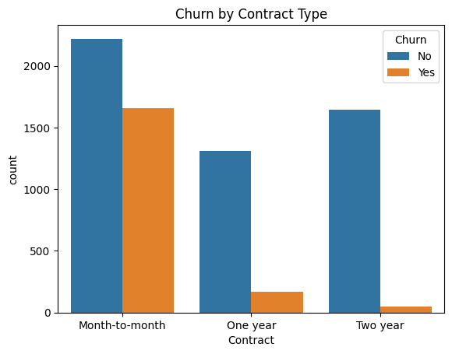
Exploratory Data Analysis
Overall Churn Analysis
  Dataset is imbalanced (more non-churn customers)
  Accuracy alone is misleading → recall is critical
EDA Insights
New customers churn more than long-term customers
Month-to-month contracts have highest churn
High Monthly Charges → higher churn
Electronic check users churn more
Customers without partners/dependents churn more

Slide 5
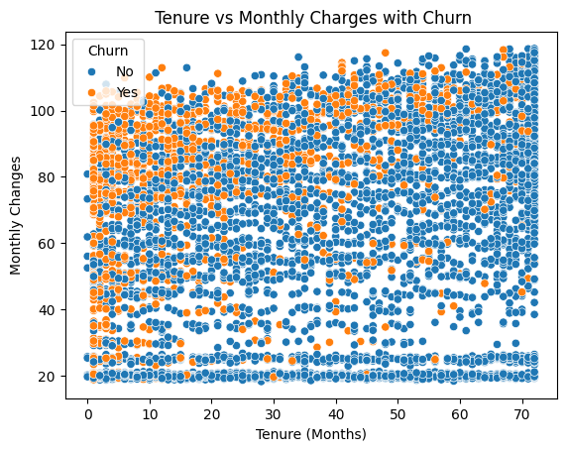
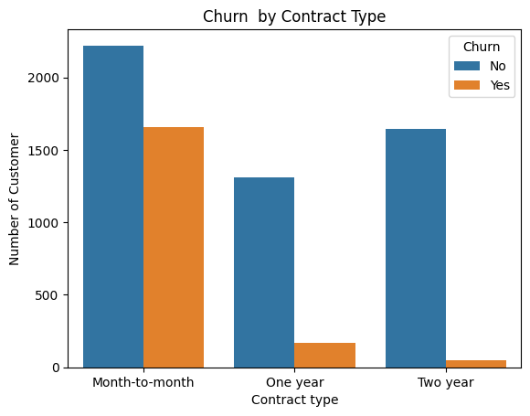
Customer Segmentation
Segmentation Features Used
  Tenure
  Monthly Charges
  Contract Type
Why These Features?
Segments Created
  Tenure → customer loyalty
  Monthly Charges → customer value
  Contract → commitment level
New vs Long-term customers
Low vs High-value customers
Contract-based segments

Slide 6
High-Risk Customer Identification
High-Risk Definition
  High Monthly Charges
  Low / medium tenure
  Month-to-month contract
  High churn probability
Business Value
  Enables targeted retention
  Prevents revenue loss

Slide 7
Churn Prediction Models
Models Implemented
  Logistic Regression
  Decision Tree
  Random Forest
  Gradient Boosting
  XGBoost
Evaluation Metrics
  Accuracy
  Precision
  Recall (MOST IMPORTANT)
  F1-Score

Slide 8
Model Comparison
Model | Accuracy | Recall (Churn)
Logistic Regression | ~80% | 55%
Decision Tree | ~74% | 49%
Random Forest | ~79% | 49–52%
Gradient Boosting | ~80% | 52%
XGBoost | ~76% | 68% ✅

Slide 9
Best Model Selection
🏆 Final Model: XGBoost
Why XGBoost?
  Highest recall for churn customers
  Identifies maximum at-risk customers
  Handles non-linear patterns
  Industry-preferred churn model
📌 Business Rule
  In churn prediction, recall is more important than accuracy.

Slide 10
Model Evaluation & Interpretation
Evaluation Techniques
  Classification report
  ROC Curve
  AUC Score
ROC & AUC
  ROC shows trade-off between True Positive Rate & False Positive Rate
  AUC measures model’s ability to separate churn vs non-churn
Feature Importance (Key Drivers)
  Tenure
  Monthly Charges
  Total Charges
  Contract Type
  Payment Method

Slide 11
Business Recommendations & Business Impact Estimation
Retention Strategies
  Offer discounts to high-risk, high-value customers
  Encourage month-to-month users to switch to long-term contracts
  Improve payment experience for electronic check users
  Early engagement programs for new customers
Expected Benefits
  Reduced churn rate
  Increased customer lifetime value
  Optimized marketing spend
  Proactive retention instead of reactive actions

Slide 12
Final Conclusion
Successfully analyzed customer churn
Identified key churn drivers
Built multiple ML models
Selected XGBoost as best model
Delivered actionable business insights
🎯 Outcome
  The model enables the business to proactively identify at-risk customers and reduce revenue loss.

